Slide 1
CMOD Platforms &
Architecture
Bud Paton
Jim Ilardi
Nov 2009

Slide 2
Platforms
iSeries
zSeries (Mainframe) native z/OS
Multiplatform
  xSeries (Windows, Linux)
  Linux on System z
  pSeries (AIX)
  Sun
  HP
Mixed (combinations)

Slide 3
iSeries
Unique in industry as “turn key” system
Heavily sold and supported by Business Partners
90 % equal to CMOD Multiplatform
  Operational differences (commands,etc)
Use Business Partners
Older versions may need migration
CMOD on iSeries sometimes lags behind Multiplatforms
  V7.1 current

Slide 4
z/OS
Large install base
Most code runs in Unix System Services - USS
Most customers run OAM for storage
  Can use TSM or VSAM
Use IBM Services to implement
Uses RACF or ACF2 for security
Requires DB2 on mainframe (not supplied)
Only CMOD that requires $$$ for server code
Optional feature OnDemand Distribution Facility – ODF and PDF Indexer
Beware of PDF Indexer on z/OS…bad performance
  Use small Windows system

Slide 5
Windows - xSeries
Windows 2003 SP2 or 2008 SP1
Least scalable due to Windows
Easiness to install / upgrade
SQL Server db lease experience
  SQL Server 2005 SP1
Careful of .NET requirements
CMOD on Windows runs as 32bit “today”

Slide 6
AIX
AIX - 5.3 or 6.1
pSeries
  p5 or p6 chipset
    Not tested on P7 “yet”
Most experience
Extremely scalable
Easy install

Slide 7
Linux
Like AIX
Easy install
Redhat (xSeries)
  RedHat - RHES release 4 U4 Kernel (2.6.9 glibc-2.3.4)
SUSE (xSeries)
  SuSE - SLES 10 Kernel (2.6.16 glibc-2.4-31) DB2 - 9.1 Oracle - 10g TSM - 5.4
Linux on System z (mainframe)
  RedHat - RHEL release 5 U0 Kernel (2.6.18-8.el5 glibc-2.5-12) SuSE
  SLES 10 Kernel (2.6.16 glibc-2.4-31) DB2 - 9.1 TSM - 5.4

Slide 8
Sun
Good experience
Performance issues with SUN - ACIF
Not as good as AIX
Usually includes Oracle db
Care they don’t want to “rack” oracle
SunOS - 5.10 DB2 - 9.1 Oracle - 10g TSM - 5.4

Slide 9
HP
Very few CMOD HP systems
HP UX not intel HP systems (windows)
Only runs on old hardware
HP-UX - B11.23 (11i v3)

Slide 10
Operating Software supported
AIX: AIX - 5.3
DB2 - 9.1
Oracle - 10g
TSM - 5.4
HP-UX: HP-UX - B11.23 (11i v3)
DB2 - 9.1
Oracle - 10g
TSM - 5.4.1
SunOS: SunOS - 5.10 DB2 - 9.1 Oracle - 10g TSM - 5.4
Windows: Windows - 2003 R2 DB2 - 9.1 Oracle - 10g SQL Server - 2005 TSM - 5.4
Linux: RedHat - RHES release 4 U4 Kernel (2.6.9 glibc-2.3.4)
SuSE - SLES 10 Kernel (2.6.16 glibc-2.4-31) DB2 - 9.1 Oracle - 10g TSM - 5.4
Linux on System z: RedHat - RHEL release 5 U0 Kernel (2.6.18-8.el5 glibc-2.5-12) SuSE - SLES 10 Kernel (2.6.16 glibc-2.4-31) DB2 - 9.1 TSM - 5.4
Currency testing
  AIX V6.1
  Windows Server 2008 SP1
  HP-UX 11i v3
  Oracle 11g
  DB2 V9.5
  TSM V5.5 and V6.1

Slide 11
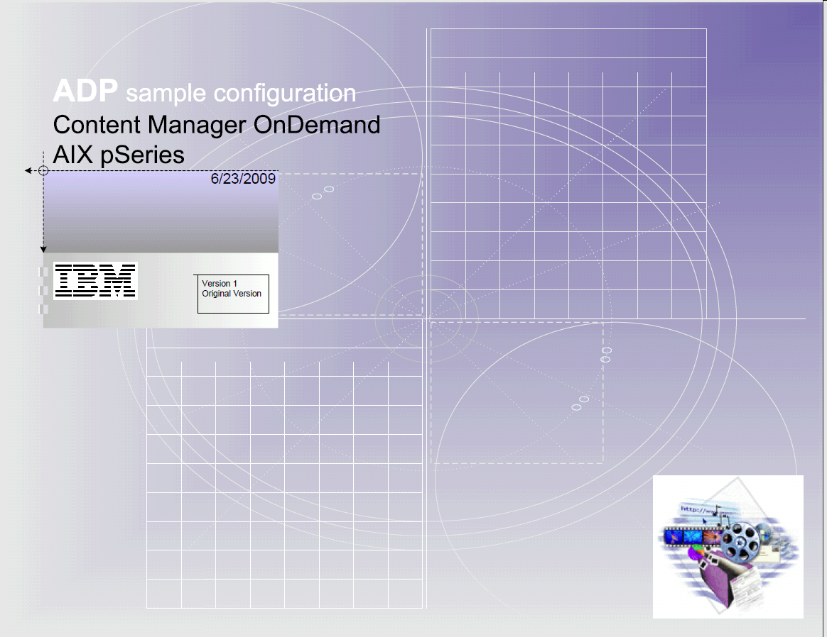
Architecture examples

Slide 12
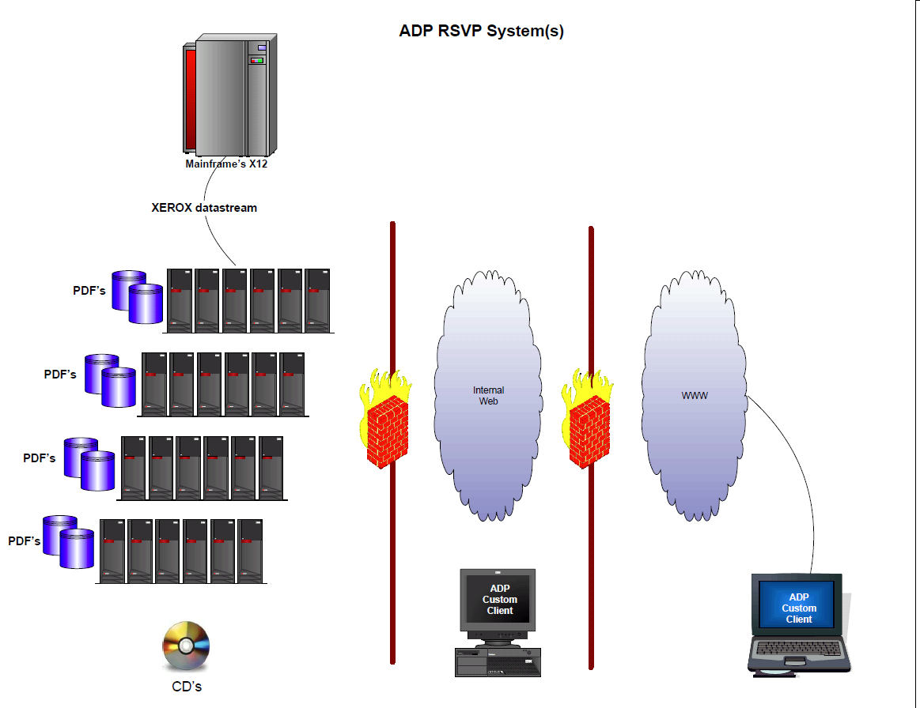

Slide 13
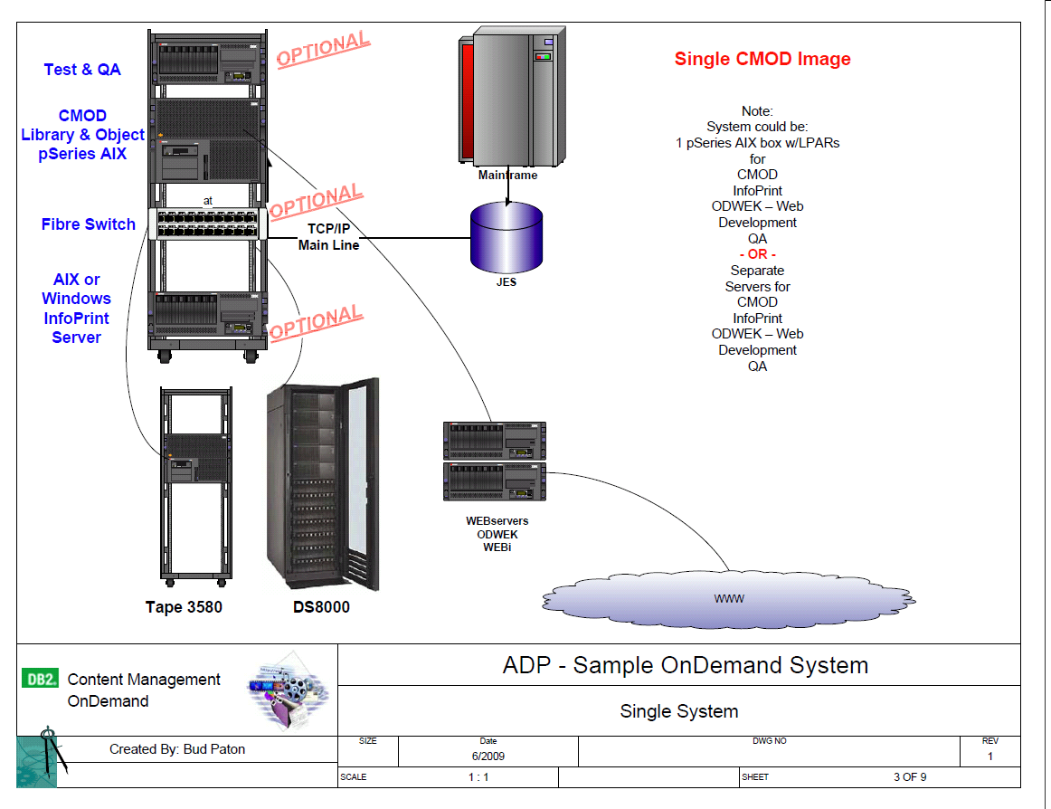

Slide 14
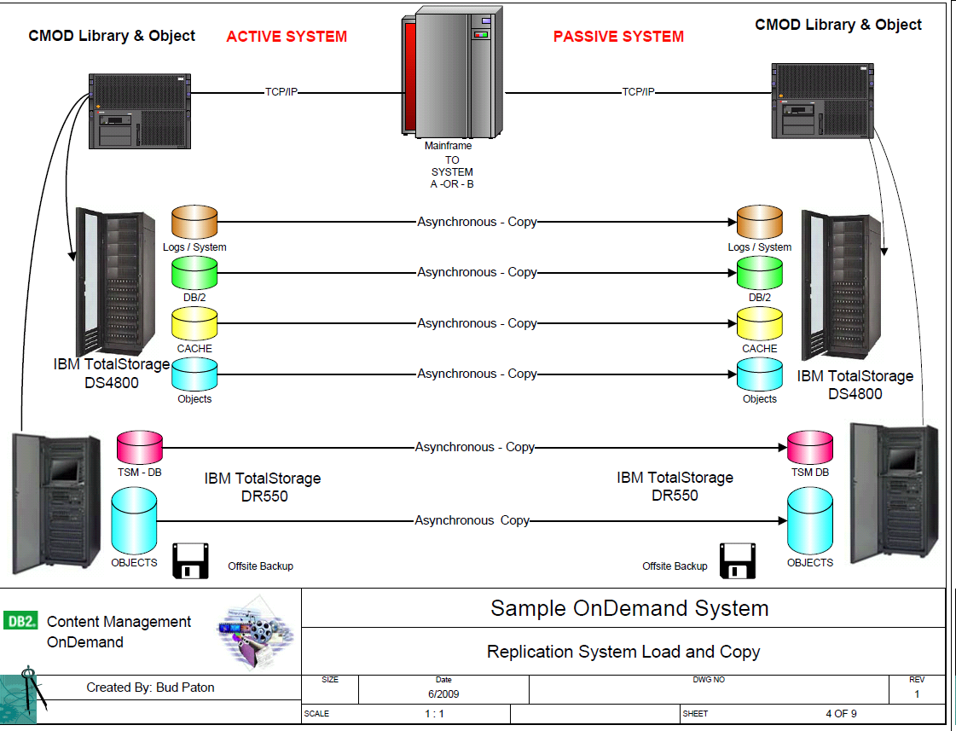

Slide 15
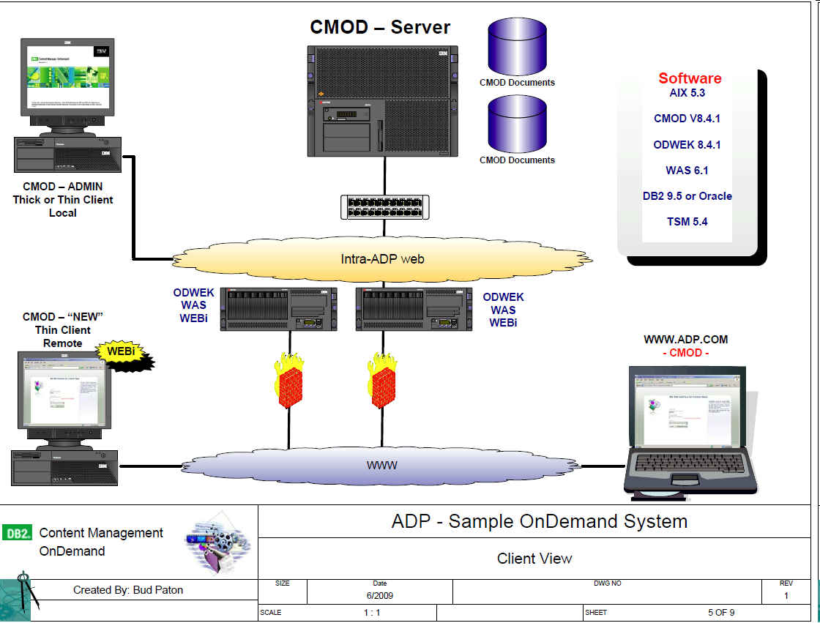

Slide 16
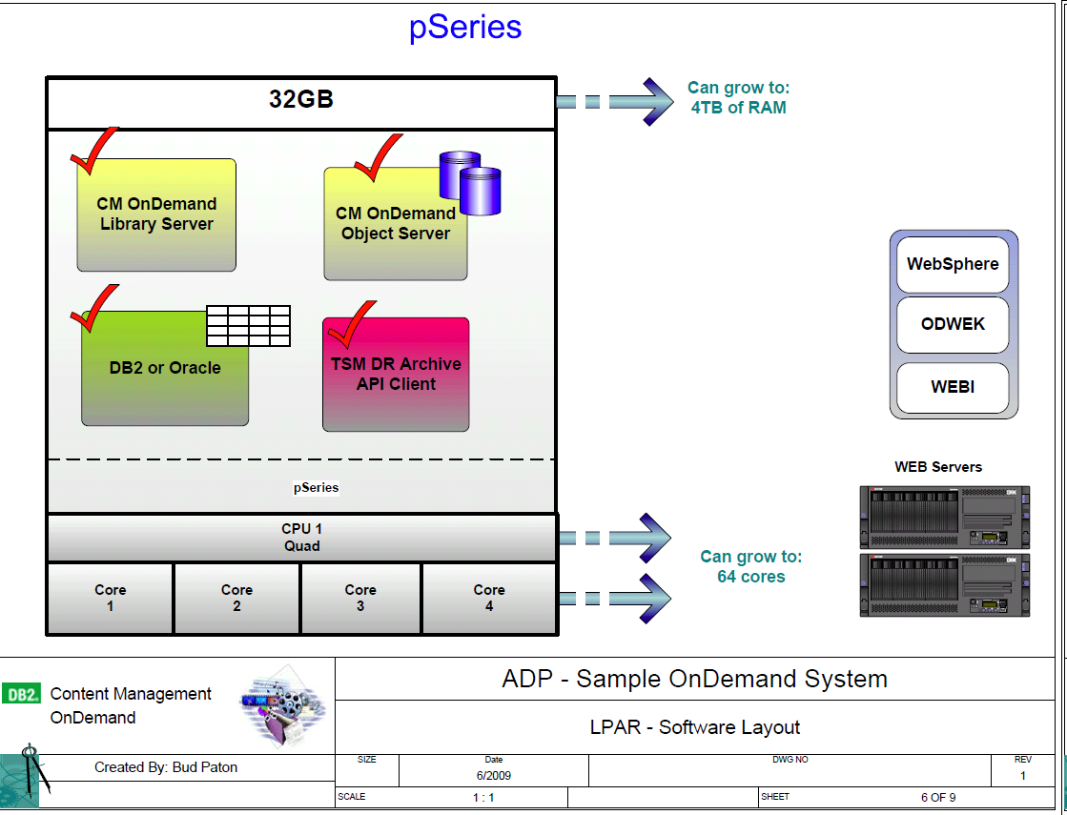

Slide 17
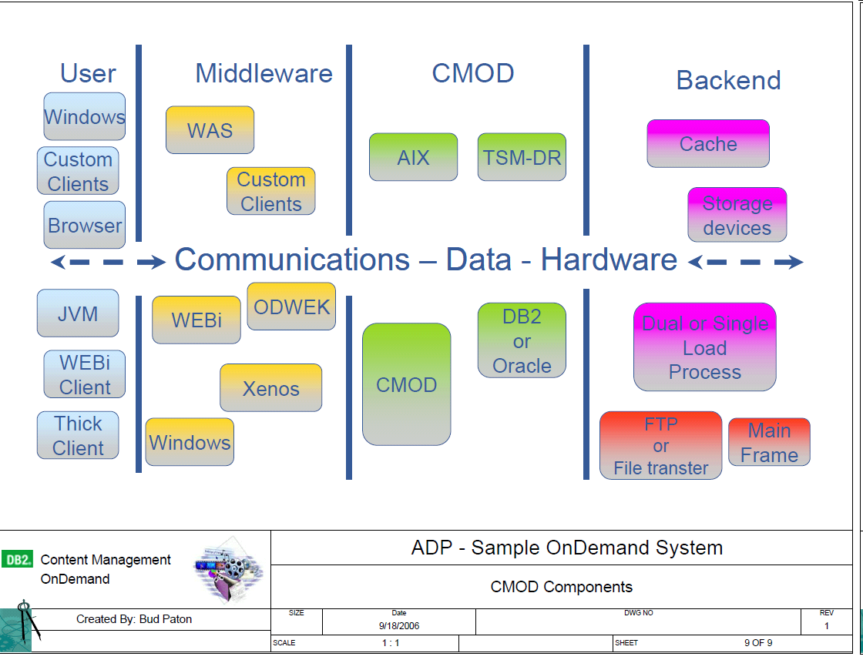

Slide 18
Additional “stuff”
Architecture drawings
  ADP
  Banamex
  POLO
  Pearson
SNAP Shots
  Deutsche Bank
  Citizens
  Broadridge

